Slide 1
Vhtek Leak Test
By: CJ Longoria and Mitchell Harmon

Slide 2
Who/What is VHtek
Vector Horizon Technologies, LLC services customers in the clean power and renewable energy industry. They provide custom engineered components and assemblies on a prototype and/or volume production basis, consulting services, and comprehensive supply chain management

Slide 3
Scope and Main Objectives
Revise previous coding to allow for more efficient and modular testing
Utilize DAQmx cards and LabView to manipulate valve system
Perform a leak test by pressurizing and measuring flow of a manifold
Measure data from leak test and determine a pass or fail state

Slide 4
Valve System Overlay

Slide 5
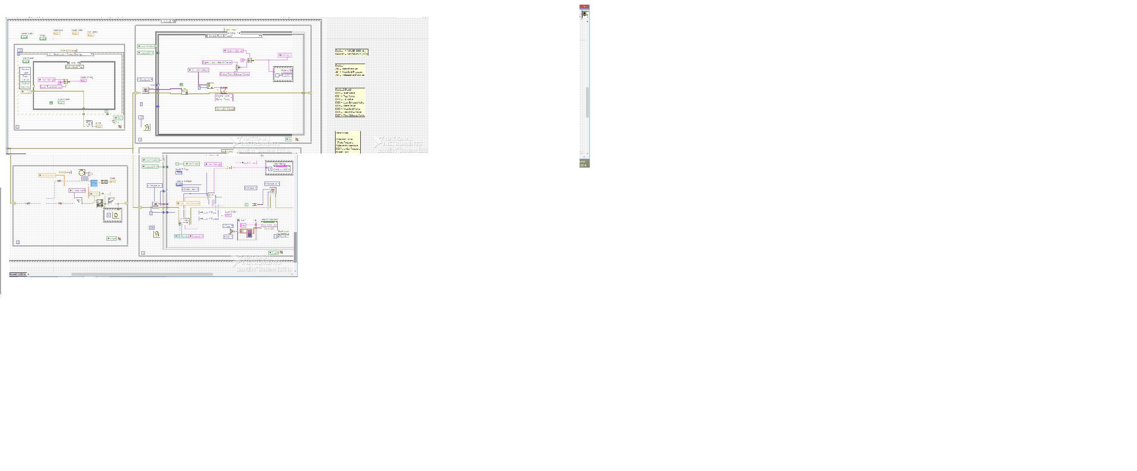
Previous Code

Slide 6
Main Body Coding

Slide 7
Individual Concepts

Slide 8
SubVi - D/O Handler

Slide 9
SubVi - Leak Status

Slide 10
SubVi - Leak History

Slide 11
SubVi - Analog Handler

Slide 12
Thank you for all the help and support!!
Dr. Harper
Jon Bigley
Oswald Baasch
Travis Poulton

