Slide 1
Touchscreen
By Stacy Hicks

Slide 2
Presentation Outline
Project Description & Goals
Hardware Used
Circuitry & Connections
Communication
Software & Programming
End Result

Slide 3
Project Description, Motivation & Goals
Korry Electronics
Electronics company which specializes in “human-machine interface”
Area of focus: Cockpit controls
Motivation:
The functionality and accuracy of touchscreen devices can degrade with repeated use.
This is part of a larger project designed to test the breakdown of touchscreen accuracy over time
The goal of this project was to create a method for determining and recording the point at which the touchscreen “registers” the touch, so that this can be compared to the position of the actual touch

Slide 4
Hardware
myRio
STMPE610 Controller
Touchscreen

Slide 5
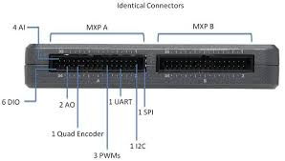
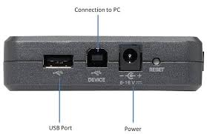
myRIO

Slide 6
STMPE610 Controller
The STMPE610 controller receives the data from the touchscreen
The actual chip is in the center of the blue breakout board shown in photo to left

Slide 7
Touchscreen
2 layer touchscreen with layers separated by dots
Effectively, the touchscreen is a voltage divider. When touched, circuit is completed and measured voltage tells position of registered touch

Slide 8
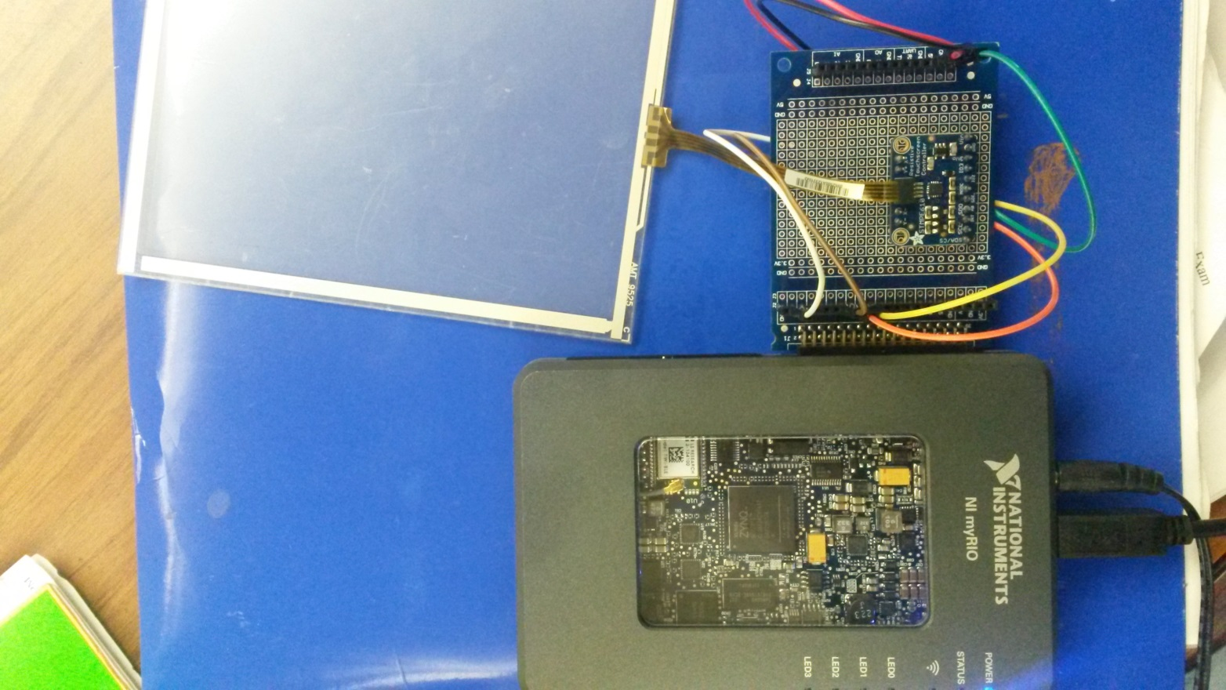
Circuitry & Connections

Slide 9
Synchronous Communication
STMPE610 controller uses either I2C or SPI communication which are both synchronous communication
Unlike other methods, communication is an exchange of information
During each communication event, the sender sends a bit and the receiver sends a bit back to the sender
Synchronous Communication use a “clock”
For each falling edge of the clock a bit is transmitted (exchanged)
SPI (Serial Peripheral Interface) communication uses master/slave mode

Slide 10
SPI Communication
SPI (Serial Peripheral Interface) communication uses master/slave mode
MISO-Master In Slave Out
MOSI-Master Out Slave In
MyRIO acts as Master
STMPE610 controller acts as slave

Slide 11
Software & Programming Overview
Setup communication parameters
Startup & initialize commination with myRIO
Write/Read Data
Read Data
Output

Slide 12
Main VI
True Case

Slide 13
Main VI
False Case

Slide 14
Main VI
User Interface

Slide 15
Startup & Data Acquisition
“Startup” sub vi

Slide 16
Write/Read Data

Slide 17
Interpreting the Data

Slide 18
Interpreting the Data
Lump coordinate information received in 4 bytes
X is 12 bits, Y is 12 bits, Z is 8 bits
Bytes come in as a hexidecimal address and x, y, z coordinate information must be separated from the 4 bytes written/read
X X
X Y
Y Y
Z Z

Slide 19
Interpreting the Data
“Read” subvi

Slide 20
Possible Future Work
Based on current results accuracy of touch readout could be improved.

