Slide 1
Korry Force Feedback Project
WKU Department of Physics and Engineering
Dr. Doug Harper
Kaitlyn Oliver Butler
Julian Heinze

Slide 2
Korry Friction Device
Device used to measure horizontal forces on a surface to calculate the coefficient of friction between the surface and the user’s finger.
Forces on the surface are measured by a force plate
Motion of the users finger are controlled by 3 stepper motors

Slide 3
Operation of Friction Device
Stationary Platform mechanically separated from motor housing to minimize vibration noise on force plate.
Moving Platform for user to place hand on and rest finger on surface during test

Slide 4
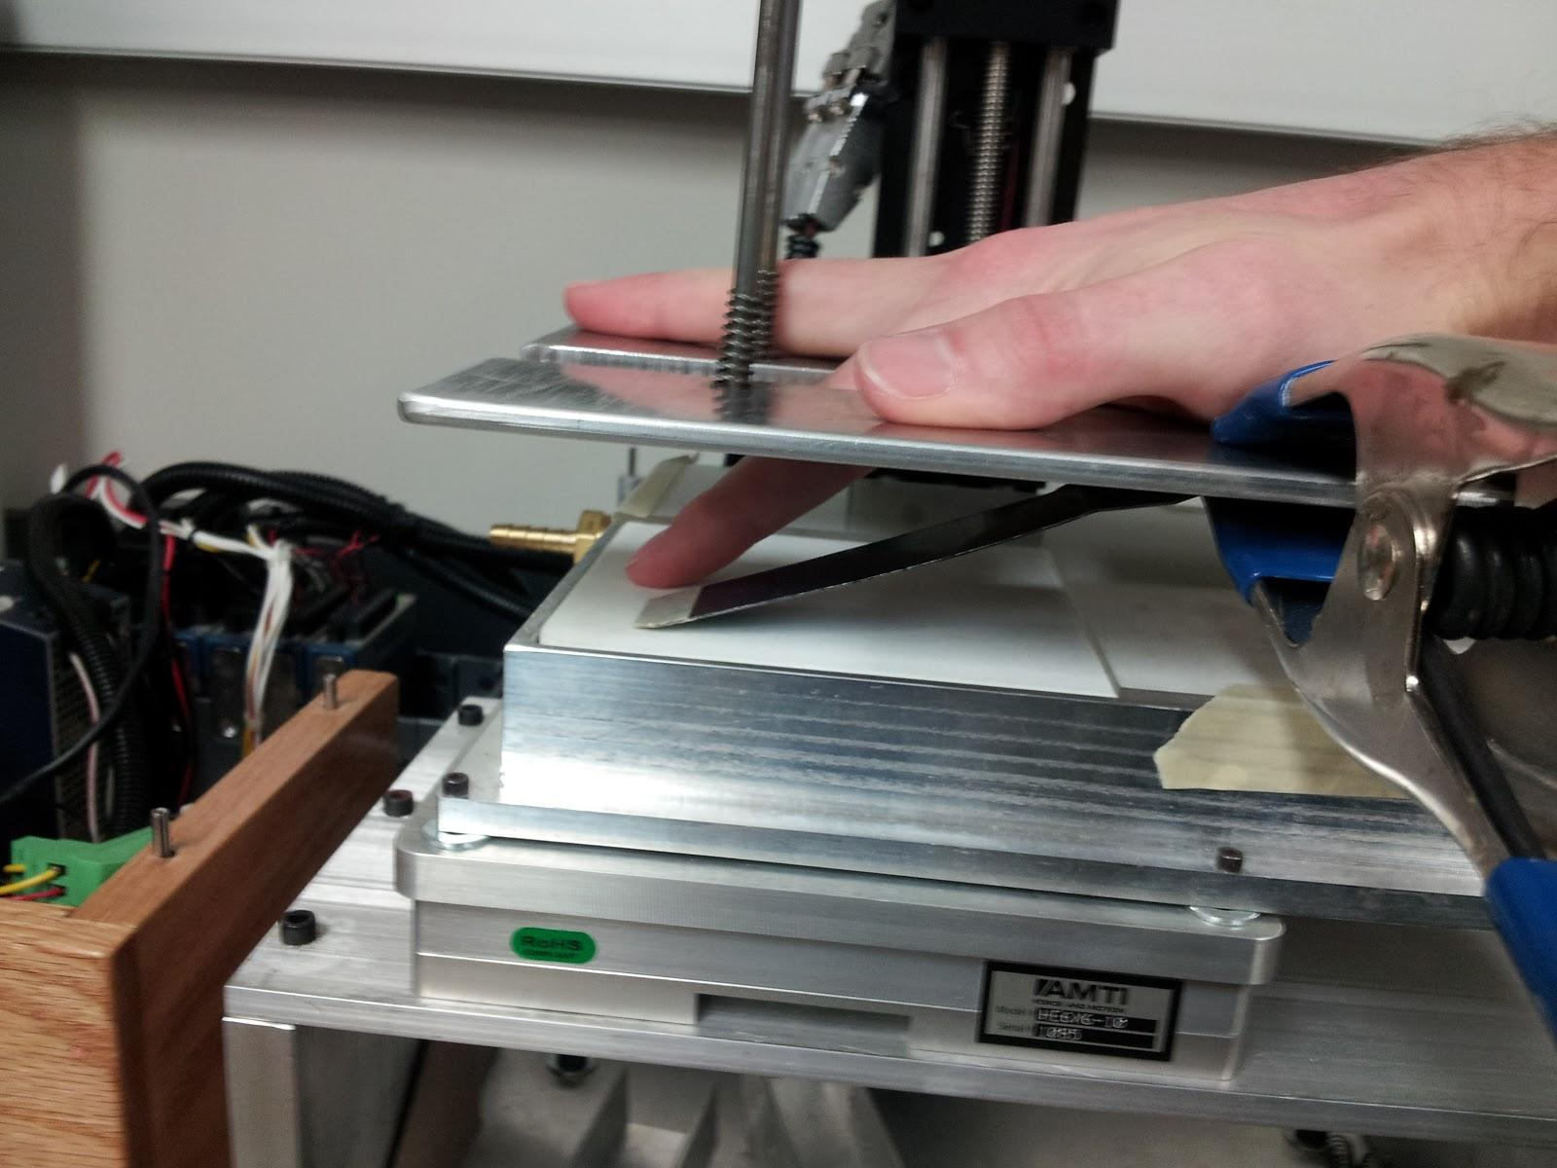

Slide 5
Main Objectives
Closed Feedback loop for z-force
Control z-distance based on z-force
Create On/Off control for Feedback

Slide 6
Program Interface
The LabVIEW Program Main Components
User Interface
cRIO
FPGA

Slide 7
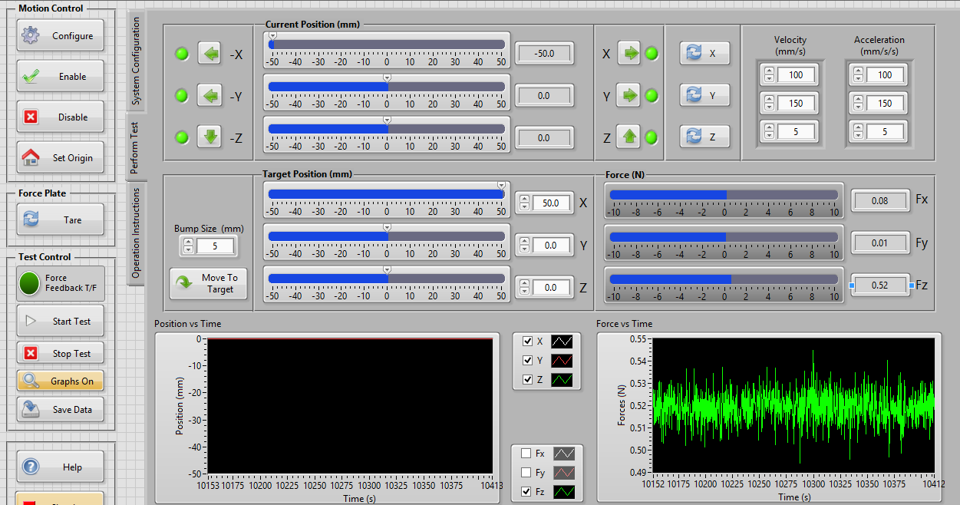
User Interface
User Interface

Slide 8
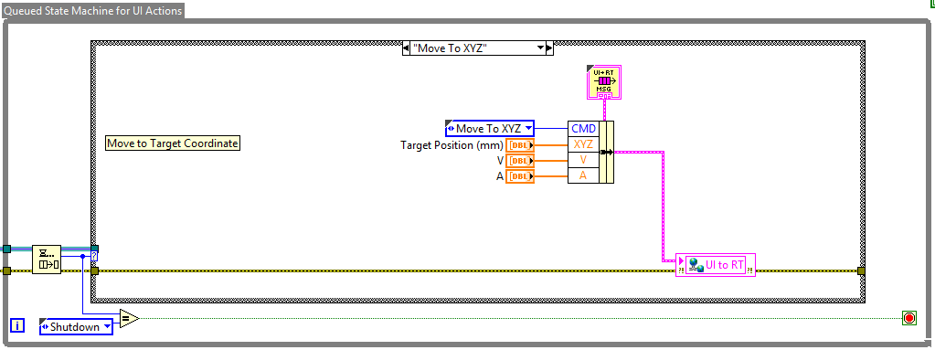
Communication Between UI and cRIO
Information is sent to the cRIO by a Shared Variable

Slide 9
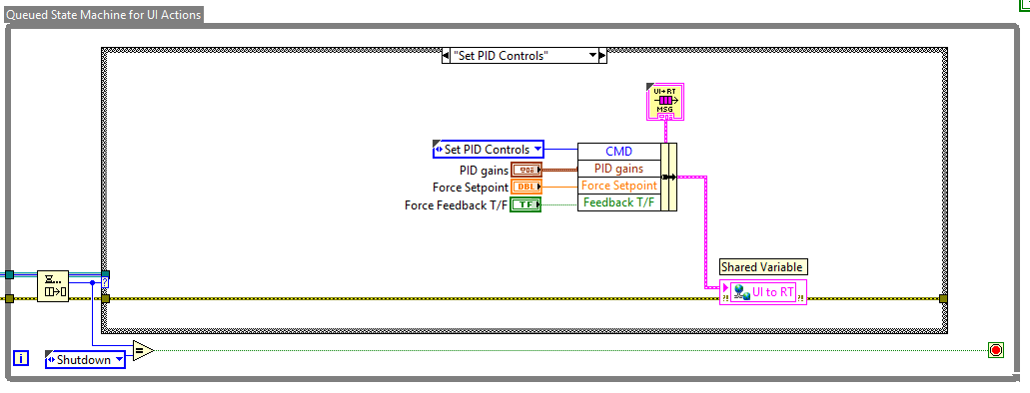
If Force Feedback is on then the PID setpoints are also bundled and sent to the shared variable

Slide 10
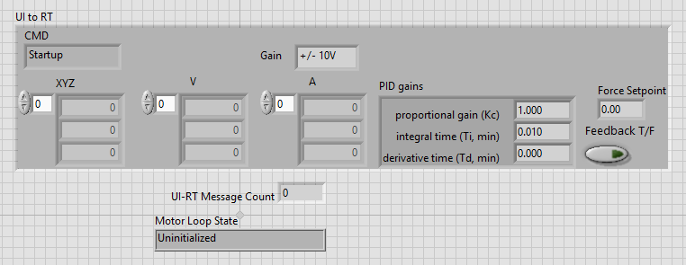
cRIO Layout

Slide 11
Once the data is received by the cRIO it is unbundled, and then sent to a Queue

Slide 12
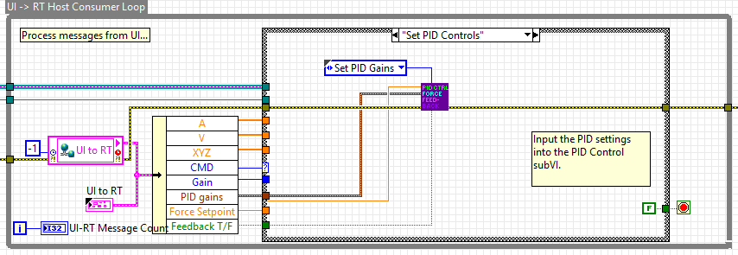
The Force Feedback setpoints are sent to the Force Feedback Virtual Instrument if Force Feedback is on

Slide 13
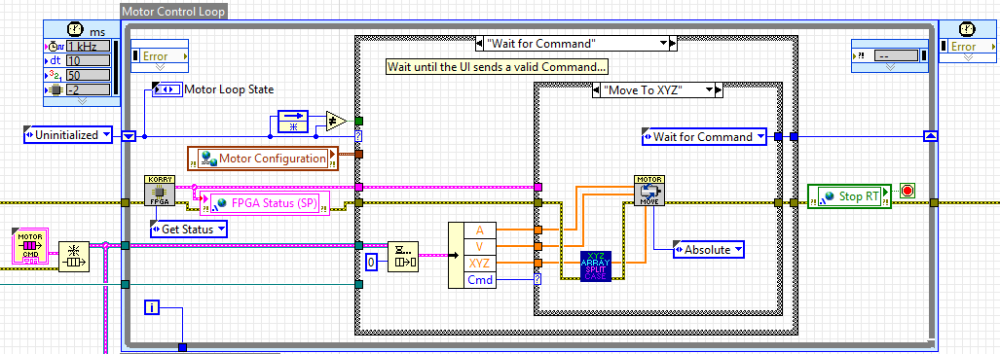
The data on the queue is then accessed and then sent to the Motor Move VI.
If Force Feedback is on then only the X&Y components are sent.
The Motor Move VI calculates a smooth profile for the Stepper Motors to prevent jerking.

Slide 14
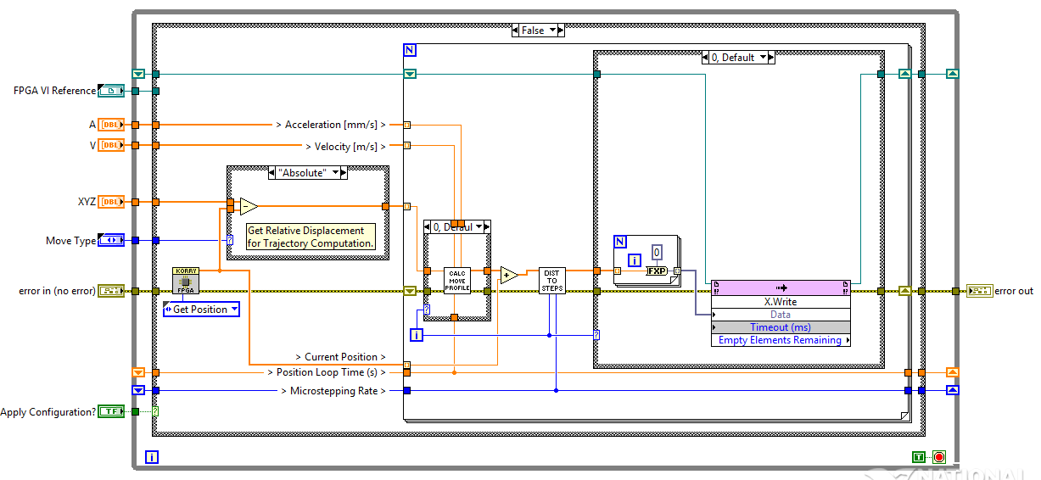
Once the Move Profile had been calculated, the data is then written to the FPGA by use of a FIFO

Slide 15
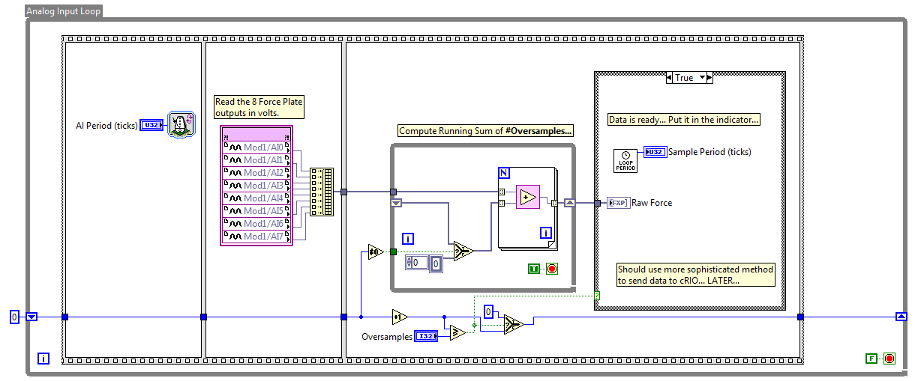
The Motors begin to move and data is collected by the FPGA from the force plate.

Slide 16
The force data is then read by the cRIO, if Force Feedback is on the force data is sent to the Feedback loop. The data is then sent to a buffer and finally sent to the User Interface by a shared variable.

Slide 17
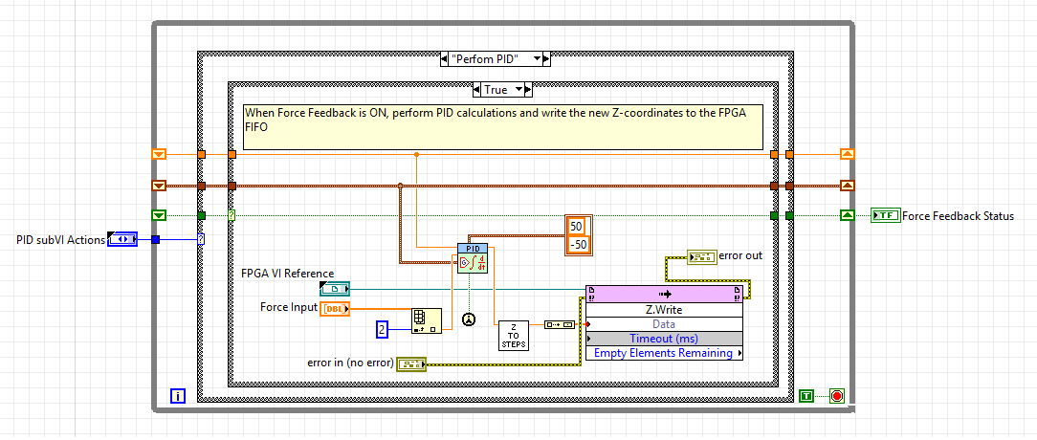
In the Feedback VI the output is written to the FIFO to control the Z-axis motor to regulate the force of the user’s finger to the desired setpoint

Slide 18
In Conclusion...
We were able to implement Force Feedback for the friction device which allows for more reliable data collection.

Slide 19
Future Work
Occasionally the Friction Device software goes unresponsive for several seconds. This is believed to be due to a communication issue between the 3 components. Changing the Shared Variables to Network Published Variables may correct this issue.

Slide 20
Credits
WKU Physics Department
WKU Engineering Department
Dr. Harper
Dr. Byrne

